Slide 1

Computational Methods in
Power System Analysis
Lecture-10 Solution of Simultaneous Algebraic Equations And Load Flow Studies
By
Dr. Wazir Muhammad Laghari
Electrical Engineering Department
BUET, Khuzdar

Slide 2
Methods to Solve Solution of Simultaneous Algebraic Equations
Direct Method Iterative Method
Elimination Decomposition
Jacobi’s
Method
Gauss-Seidel
Method
Relaxation
Method
Gaussian Elimination Method
Gauss-Jordan Method
Crout’s Reduction Method
Cholesky’s Reduction Method

Slide 4
CLASSIFICATION OF BUSES
Q: How many variables find on each bus?
Ans: Four parameters we can find on each bus such as Voltage (V), Active Power (P), Reactive Power (Q) and Angle (δ).
Q: How many variables find on 10 buses?
Ans: We find 10*4 = 40 variables, if n bus system than we find 4n variables.

Slide 6
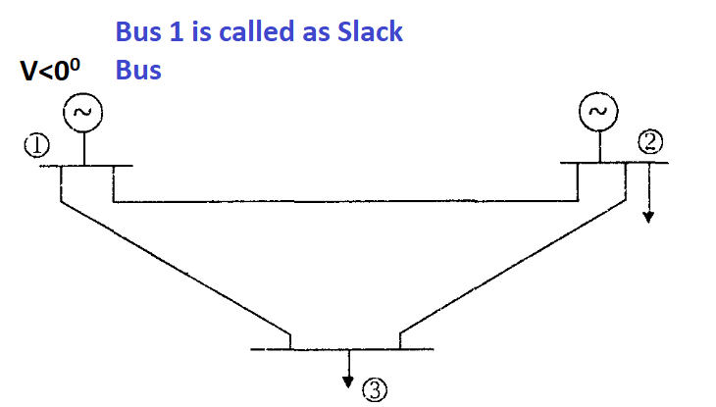
SLACK BUS
Slack Bus is also called as Reference Bus or Swing Bus.
In Slack Bus Known quantity is V and Angle and Unknown quantity is P and Q.
Q: Why Slack Bus is called as a Reference Bus?
Ans: Suppose you want to take any n-bus system or 3-bus system. So any one-bus take as a reference to compare other buses. In a reference bus we take as a zero angle to compare other buses.
Bus:1 = 1<0⁰ means we have two quantity known voltage and angle.

Slide 8
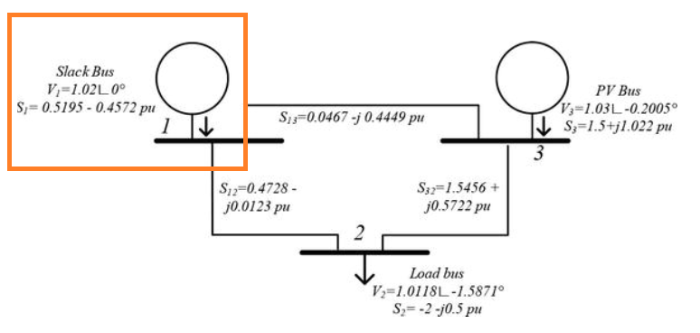
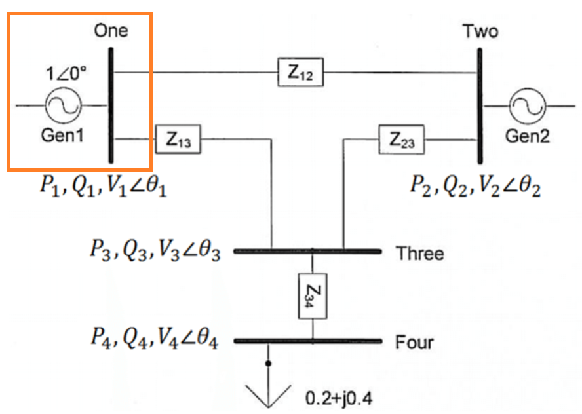
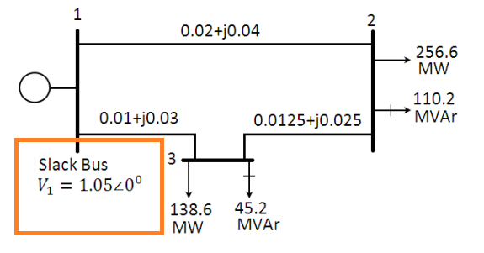
SLACK BUS

Slide 10
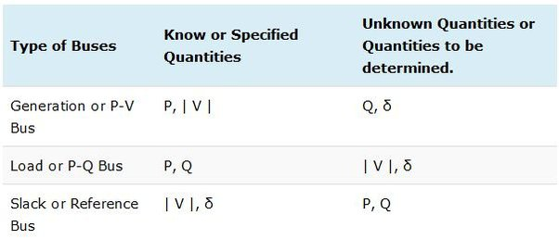
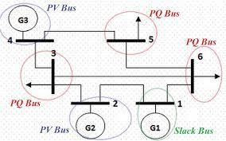
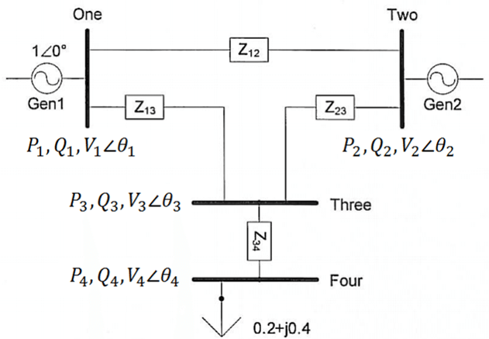

Slide 12
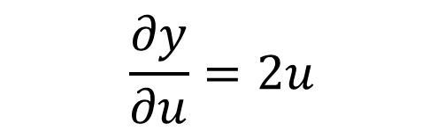

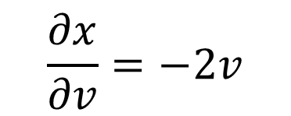


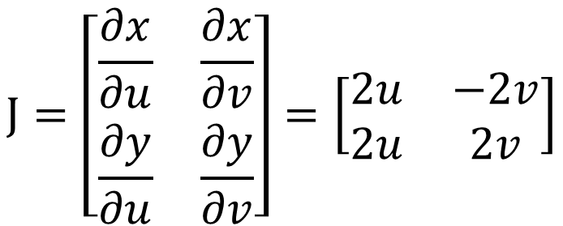

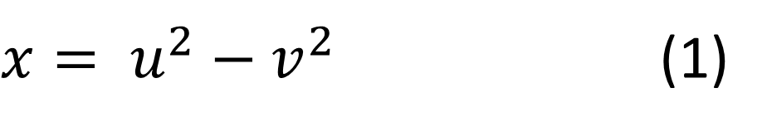
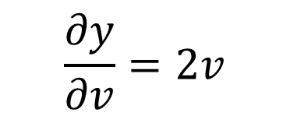
JACOBIAN MATRIX
Q: Find the Jacobian of the Transformation
$$x= u^{2}−v^{2}$$
$J=\left[\begin{matrix}J_{1} & J_{2} \\ J_{3} & J_{4}\end{matrix}\right]=\left[\begin{matrix}\frac{∂x}{∂u} & \frac{∂x}{∂v} \\ \frac{∂y}{∂u} & \frac{∂y}{∂v}\end{matrix}\right]$
$$y= u^{2}+v^{2}$$
SOLUTION
$x= u^{2}−v^{2}$ (1)
$$y= u^{2}+v^{2} (2)$$
Calculate the partial derivative of equation (1) w.r.t.u and w.r.t.y
$$\frac{∂x}{∂u}=2u$$
$$\frac{∂x}{∂v}=−2v$$
$$J=\left[\begin{matrix}\frac{∂x}{∂u} & \frac{∂x}{∂v} \\ \frac{∂y}{∂u} & \frac{∂y}{∂v}\end{matrix}\right]=\left[\begin{matrix}2u & −2v \\ 2u & 2v\end{matrix}\right]$$
Calculate the partial derivative of equation (2) w.r.t.u and w.r.t.y
$$\frac{∂y}{∂u}=2u$$
$$\frac{∂y}{∂v}=2v$$

Slide 14
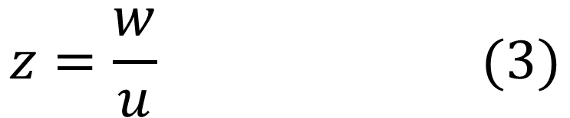
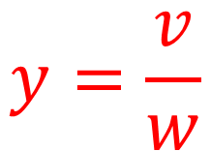
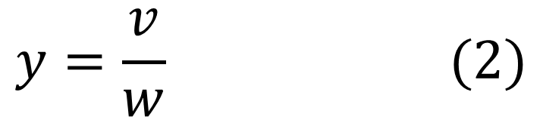
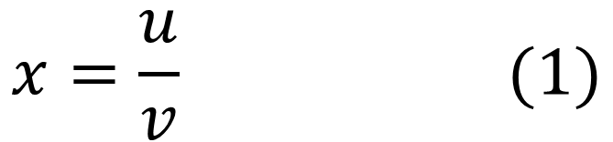
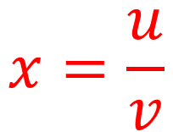
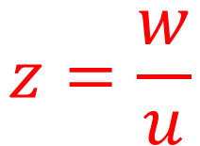

JACOBIAN MATRIX
Q: Find the Jacobian of the Transformation
$$x=\frac{u}{v}$$
$$y=\frac{v}{w}$$
$$z=\frac{w}{u}$$
SOLUTION
$J=\left[\begin{matrix}J_{1} & J_{2} & J_{3} \\ J_{4} & J_{5} & J_{6} \\ J_{7} & J_{8} & J_{9}\end{matrix}\right]=$ $\left[\begin{matrix}\frac{∂x}{∂u} & \frac{∂x}{∂v} & \frac{∂x}{∂w} \\ \frac{∂y}{∂u} & \frac{∂y}{∂v} & \frac{∂y}{∂w} \\ \frac{∂z}{∂u} & \frac{∂z}{∂v} & \frac{∂z}{∂w}\end{matrix}\right]$
$$x=\frac{u}{v} (1)$$
$$y=\frac{v}{w} (2)$$
$$z=\frac{w}{u} (3)$$

Slide 16
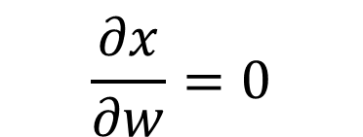
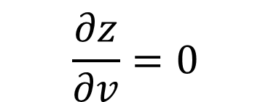
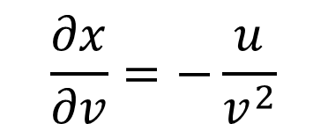
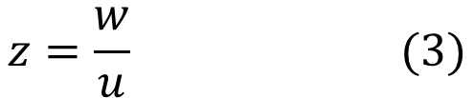
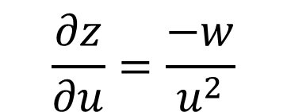
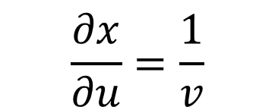
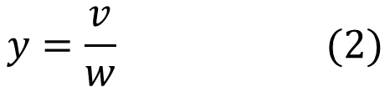
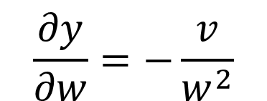
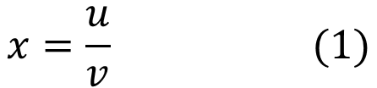
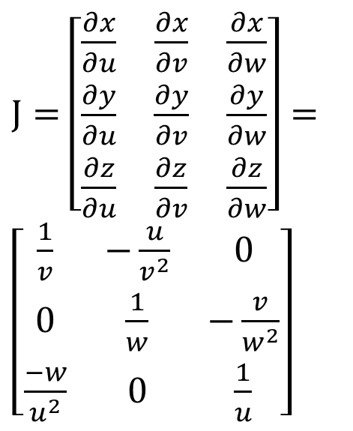
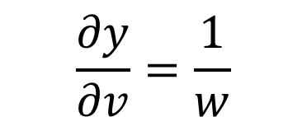

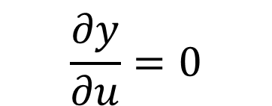
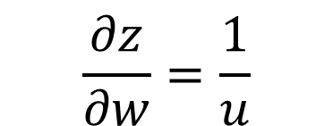
JACOBIAN MATRIX
$$x=\frac{u}{v} (1)$$
$J=\left[\begin{matrix}J_{1} & J_{2} & J_{3} \\ J_{4} & J_{5} & J_{6} \\ J_{7} & J_{8} & J_{9}\end{matrix}\right]=$ $\left[\begin{matrix}\frac{∂x}{∂u} & \frac{∂x}{∂v} & \frac{∂x}{∂w} \\ \frac{∂y}{∂u} & \frac{∂y}{∂v} & \frac{∂y}{∂w} \\ \frac{∂z}{∂u} & \frac{∂z}{∂v} & \frac{∂z}{∂w}\end{matrix}\right]$
$$y=\frac{v}{w} (2)$$
$$z=\frac{w}{u} (3)$$
Calculate the partial derivative of equation (1) w.r.t.u , w.r.t.v, and w.r.t.w
$$\frac{∂x}{∂v}=−\frac{u}{v^{2}}$$
$J=$ $\left[\begin{matrix}\frac{∂x}{∂u} & \frac{∂x}{∂v} & \frac{∂x}{∂w} \\ \frac{∂y}{∂u} & \frac{∂y}{∂v} & \frac{∂y}{∂w} \\ \frac{∂z}{∂u} & \frac{∂z}{∂v} & \frac{∂z}{∂w}\end{matrix}\right]=\left[\begin{matrix}\frac{1}{v} & −\frac{u}{v^{2}} & 0 \\ 0 & \frac{1}{w} & −\frac{v}{w^{2}} \\ \frac{−w}{u^{2}} & 0 & \frac{1}{u}\end{matrix}\right]$
$$\frac{∂x}{∂u}=\frac{1}{v}$$
$$\frac{∂x}{∂w}=0$$
Calculate the partial derivative of equation (2) w.r.t.u , w.r.t.v, and w.r.t.w
$$\frac{∂y}{∂u}=0$$
$$\frac{∂y}{∂v}=\frac{1}{w}$$
$$\frac{∂y}{∂w}=−\frac{v}{w^{2}}$$
Calculate the partial derivative of equation (3) w.r.t.u , w.r.t.v, and w.r.t.w
$$\frac{∂z}{∂u}=\frac{−w}{u^{2}}$$
$$\frac{∂z}{∂v}=0$$
$$\frac{∂z}{∂w}=\frac{1}{u}$$

Slide 18
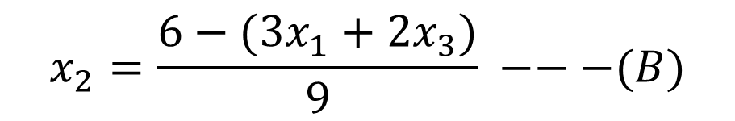

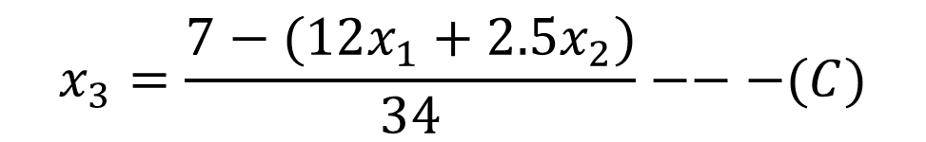


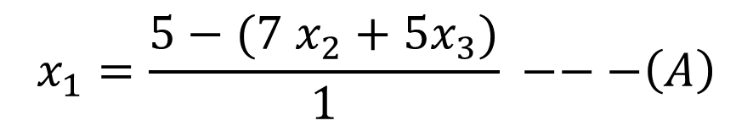

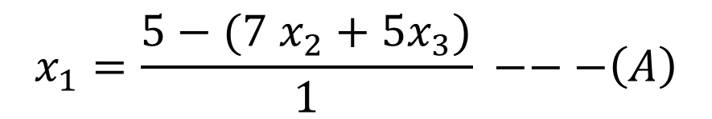
Gauss Seidal Method
$$Q:Consider the following system of linear equations, using Gauss Seidal$$
$Method$ to solve next iteration
$x_{1}+7$ $x_{2}+5x_{3}=5$
$$3x_{1}+9x_{2}+2x_{3}=6$$
${12x}_{1}+2.5$ $x_{2}+34x_{3}=7$
$$x_{1}=\frac{5−(7 x_{2}+5x_{3})}{1} −−−\left(A\right)$$
$SOLUTION$:
$$x_{1}=\frac{5−(7 x_{2}+5x_{3})}{1} −−−\left(A\right)$$
$$x_{2}=\frac{6−(3x_{1}+2x_{3})}{9} −−−(B)$$
$$x_{3}=\frac{7−(12x_{1}+2.5x_{2})}{34}−−−(C)$$

Slide 20
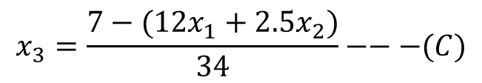
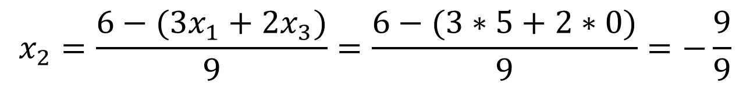

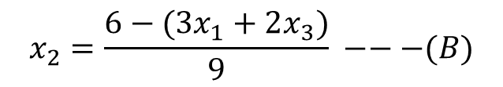
Gauss Seidal Method
First Iteration $Initial guess{ x}_{1}=0,x_{2}=0,x_{3}=0$
$$x_{1}=5−(7 x_{2}+5x_{3})−−−\left(A\right)$$
$$x_{2}=\frac{6−(3x_{1}+2x_{3})}{9} −−−(B)$$
$$x_{1}=5−(7 x_{2}+5x_{3})=5 −(7∗0+5∗0)=5$$
$$x_{3}=\frac{7−(12x_{1}+2.5x_{2})}{34}−−−(C)$$
$$x_{2}=\frac{6−(3x_{1}+2x_{3})}{9}=\frac{6−(3∗5+2∗0)}{9}=−\frac{9}{9}$$
$$x_{3}= \frac{7−(12x_{1}+2.5x_{2})}{34}=\frac{7−(12∗5+2.5(−1))}{34}=−1.485$$
Second Iteration Put values ${ x}_{1}=5,x_{2}=−1,x_{3}=1.485$
$$x_{1}=5−(7 x_{2}+5x_{3})=5 −7∗\left(−1\right)−5∗\left(1.485\right)=4.575$$
$$x_{2}=\frac{6−(3x_{1}+2x_{3})}{9}=\frac{6−(3∗4.575+2∗1.485)}{9}=−1.188$$
$$x_{3}= \frac{7−(12x_{1}+2.5x_{2})}{34}=\frac{7−(12∗4.575+2.5(−1.188))}{34}=−1.321$$

Slide 22
Three Buses
Slack Bus or Reference Bus only Voltage and Angle specified
Generator Bus (PV Bus) P and V is Specified.
Load Bus (PQ Bus) P and Q is Specified.

Slide 24
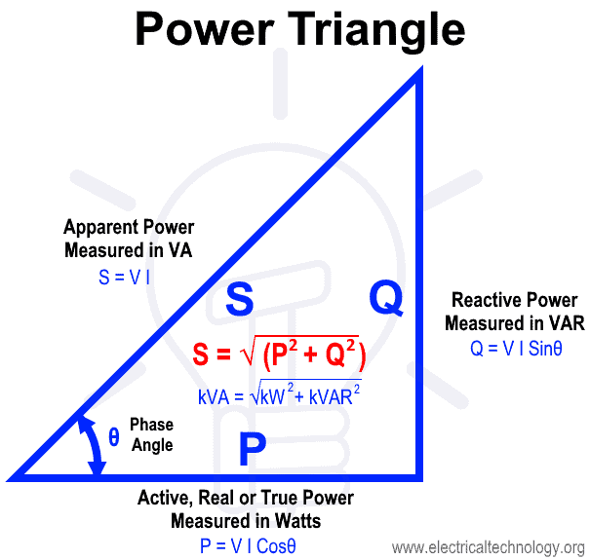





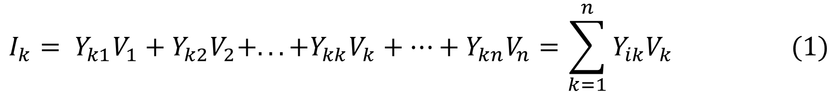
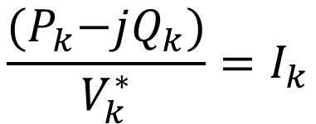
$$V=IZ$$
$$I=\frac{V}{Z}=YV$$
$$I_{k}= Y_{k1}V_{1}+Y_{k2}V_{2}+. . .{+Y}_{kk}V_{k}+…+Y_{kn}V_{n}=\sum_{k=1}^{n}{Y_{ik}V_{k} (1)}$$
$S=P+jQ=VI$
$$S^{∗}=P−jQ=V^{∗}I$$
$$S_{k}^{∗}=P_{k}−jQ_{k}=V_{k}^{∗}I_{k}$$
$$\frac{{(P}_{k}−jQ_{k})}{V_{k}^{∗}}=I_{k}$$
$I_{k}=\frac{1}{V_{k}^{∗}}{(P}_{k}−jQ_{k}) (4)$

Slide 26
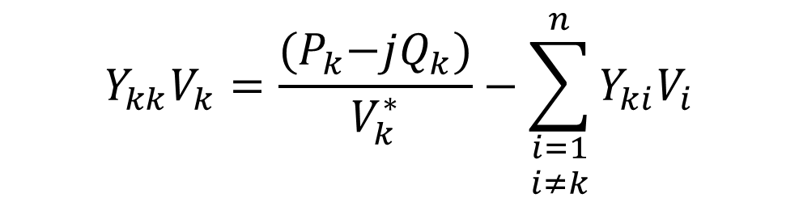

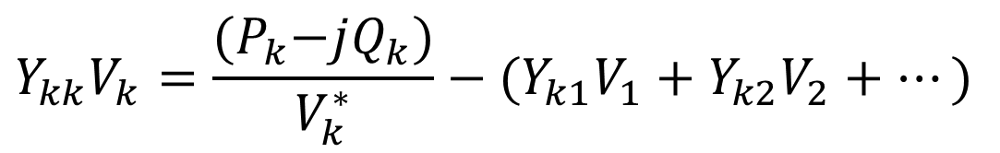
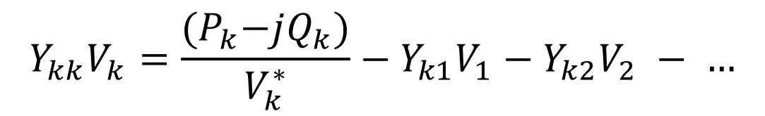
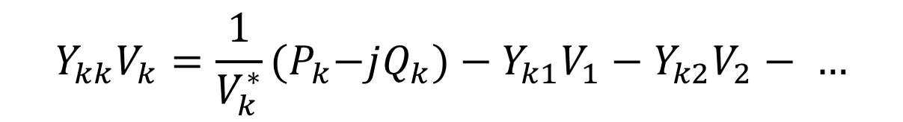
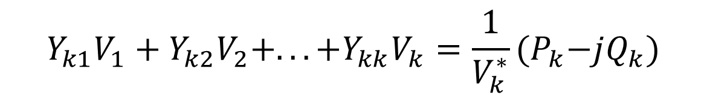
Compare Equation (1) and (4)
$$I_{j}= Y_{k1}V_{1}+Y_{k2}V_{2}+. . .{+Y}_{kk}V_{k}+…+Y_{kn}V_{n}=\sum_{i=1}^{n}{Y_{ki}V_{i} (1)}$$
$I_{k}= \frac{1}{V_{k}^{∗}}{(P}_{k}−jQ_{k}) (4)$
$$Y_{k1}V_{1}+Y_{k2}V_{2}+. . .{+Y}_{kk}V_{k}=\frac{1}{V_{k}^{∗}}{(P}_{k}−jQ_{k})$$
$$Y_{kk}V_{k}=\frac{1}{V_{k}^{∗}}{(P}_{k}−jQ_{k})−Y_{k1}V_{1}−Y_{k2}V_{2}− …$$
$$Y_{kk}V_{k}=\frac{{(P}_{k}−jQ_{k})}{V_{k}^{∗}}−Y_{k1}V_{1}−Y_{k2}V_{2} − …$$
$$Y_{kk}V_{k}=\frac{{(P}_{k}−jQ_{k})}{V_{k}^{∗}}−{(Y}_{k1}V_{1}+Y_{k2}V_{2}+…)$$
$$Y_{kk}V_{k}=\frac{{(P}_{k}−jQ_{k})}{V_{k}^{∗}}−\sum_{\begin{aligned}i=1 \\ i≠k\end{aligned}}^{n}{Y_{ki}V_{i}}$$

Slide 28




$$Y_{kk}V_{k}=\frac{{(P}_{k}−jQ_{k})}{V_{k}^{∗}}−\sum_{\begin{aligned}i=1 \\ i≠k\end{aligned}}^{n}{Y_{ki}V_{i}}$$
$$V_{k}=\frac{1}{Y_{kk}}\left[\frac{P_{k}−jQ_{k}}{V_{k}^{∗}}−\sum_{\begin{aligned}i=1 \\ i≠k\end{aligned}}^{n}{Y_{ki}V_{i}}\right]$$
Suppose we want equation At Bus 2, k = 2
$$V_{2}=\frac{1}{Y_{22}}\left[\frac{P_{2}−jQ_{2}}{V_{2}^{∗}}−Y_{21}V_{1}−Y_{23}V_{3} − . . . −Y_{2n}V_{n}\right]$$
Similarly, we want equation At Bus 3, k = 3
$$V_{3}=\frac{1}{Y_{33}}\left[\frac{P_{3}−jQ_{3}}{V_{3}^{∗}}−Y_{31}V_{1}−Y_{32}V_{2} − . . . −Y_{3n}V_{n}\right]$$

Slide 30




$$Y_{kk}V_{k}=\frac{{(P}_{k}−jQ_{k})}{V_{k}^{∗}}−\sum_{\begin{aligned}i=1 \\ i≠k\end{aligned}}^{n}{Y_{ki}V_{i}}$$
$$V_{k}=\frac{1}{Y_{kk}}\left[\frac{P_{k}−jQ_{k}}{V_{k}^{∗}}−\sum_{\begin{aligned}i=1 \\ i≠k\end{aligned}}^{n}{Y_{ki}V_{i}}\right]$$
$$Let k=2 and n=1 to 3 bus system$$
$${Y_{22}V}_{2}=\left[\frac{P_{2}−jQ_{2}}{V_{2}^{∗}}−Y_{21}V_{1}−Y_{23}V_{3}− …−Y_{2n}V_{n}\right]$$
$$V_{2}=\frac{1}{Y_{22}}\left[\frac{P_{2}−jQ_{2}}{V_{2}^{∗}}−Y_{21}V_{1}−Y_{23}V_{3}− …−Y_{2n}V_{n}\right]$$

Slide 32


Line Impedances = R + jX
Iterative method is used to solve non-linear equations and it will start with guess values
Here we apply Iterative method for one iteration and find the voltages of four buses V₁, V₂, V₃, V₄

Slide 34







$Y_{12}=\frac{1}{Z_{12}}$ $=\frac{1}{0.05+j0.15}=2−j6$
$Y_{24}=\frac{1}{Z_{24}}$ $=\frac{1}{0.10+j0.30}=1−j3$
$Y_{13}=\frac{1}{Z_{13}}$ $=\frac{1}{0.10+j0.30}=1−j3$
$Y_{34}=\frac{1}{Z_{34}}$ $=\frac{1}{0.05+j0.15}=2−j6$
$Y_{14}=\frac{1}{Z_{14}}$ $=\frac{1}{0.20+j0.40}=1−j2$

Slide 36


Slide 38


Slide 40


Slide 42


Slide 44


